Slide 1



KRAF THINK 2025 HACKATHON
Empowering innovation, fostering collaboration, and transforming ideas into reality – join the Kraf Think 2025 Hackathon revolution!
Team Name : Code Busters
Team Leader Name : Yuvraj Rana
Team Members Name : Yuvraj Rana
Shivam Mehta
Ujjwal Mishra
Rishikesh Shukla

Slide 2
Table of contents
01
04
02
05
03
06
Cover Slide
Scheduling
Content creation
Format and design
Review and editing
Final review

Slide 3
1. Cover Letter
To, The Organizers, Kraf Think 2025 Hackathon Subject: Submission of Project TriNetra
Dear Sir/Madam,
We are pleased to submit our project, TriNetra, as our entry for the Kraf Think 2025 Hackathon. Our team, TriNetra, consisting of Yuvraj Rana, Shivam Mehta, Rishikesh Shukla, and Ujjwal Mishra, has developed an innovative solution that leverages advanced techniques such as Eulerian Video Magnification for heart rate detection and Color Channel Analysis for SpO₂ estimation. Our system is designed to deliver real-time, non-contact vital sign monitoring, integrated with robust anomaly detection and alert generation functionalities, making it a comprehensive tool for modern healthcare applications. We believe that our project not only addresses critical clinical challenges but also demonstrates significant potential for scalable and practical implementation. Enclosed with this letter, please find our detailed project documentation for your review. We look forward to the opportunity to present our work and contribute to the advancement of healthcare technology through this hackathon.
Thank you for considering our submission. Sincerely, Team TriNetra Yuvraj Rana, Shivam Mehta, Rishikesh Shukla, Ujjwal Mishra

Slide 4
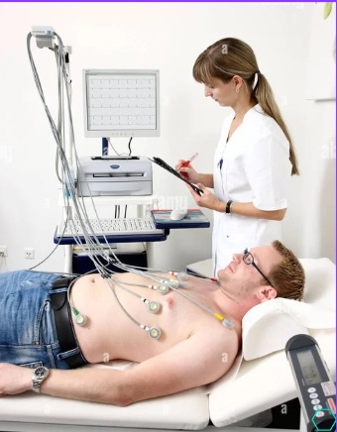
2. Problem Statement
Traditional heart rate monitoring methods face several challenges:
Non-Invasive: Chest straps and heart rate machines require contact, causing discomfort and limiting continuous use.
Medical Waste: Disposable monitoring devices contribute 15-20% of the 2 million tons of healthcare waste annually.
Cost-Ineffective: Traditional heart rate monitors range from ₹4,000 to ₹24,000, making them less accessible for continuous, non-contact monitoring.
Late Response Time: Many conventional devices have delays in detecting real-time heart rate changes, reducing effectiveness in critical situations.

Slide 5

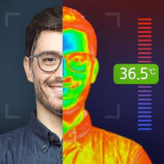

3. Solution Overview
Standard cameras integrated with AI models to monitor heart rate in real-time.
Data captured by the cameras in real time is processed locally using Jetson Nano, eliminating the need for cloud-based processing and reducing latency in vital sign analysis.
The system continuously analyzes vital signs, detects abnormalities, and triggers an alert, which is sent directly to the hospital’s control room.
Once an anomaly is detected, an alert is generated and displayed on a dedicated monitor in the control room, ensuring immediate visibility for medical staff.

Slide 6
4. Target Audience & Market Scope
Hospitals and Clinics: Healthcare providers seeking to integrate non-invasive, real-time vital sign monitoring into inpatient and outpatient settings for improved patient management.
Telemedicine Platforms: Providers offering remote consultations and monitoring services, where contactless measurement of heart rate and SpO₂ can enhance patient safety and reduce hospital visits.
Home Healthcare Solutions: Individuals and caregivers interested in continuous or periodic monitoring of at-risk populations—such as the elderly or those with chronic conditions—without the need for specialized clinical equipment.

Slide 7
5. Technology Stack
Hardware: NVIDIA Jetson Nano with a high-definition camera.
Software: Ubuntu OS, CUDA, Python/C++ with OpenCV, NumPy, and SciPy.
Algorithms: Eulerian Video Magnification for heart rate, Color Channel Analysis for SpO₂, plus integrated anomaly detection.
Integration: Real-time processing using GStreamer/RTSP within a modular, scalable architecture.
Deployment: Edge computing with potential cloud integration for enhanced scalability and performance.

Slide 8
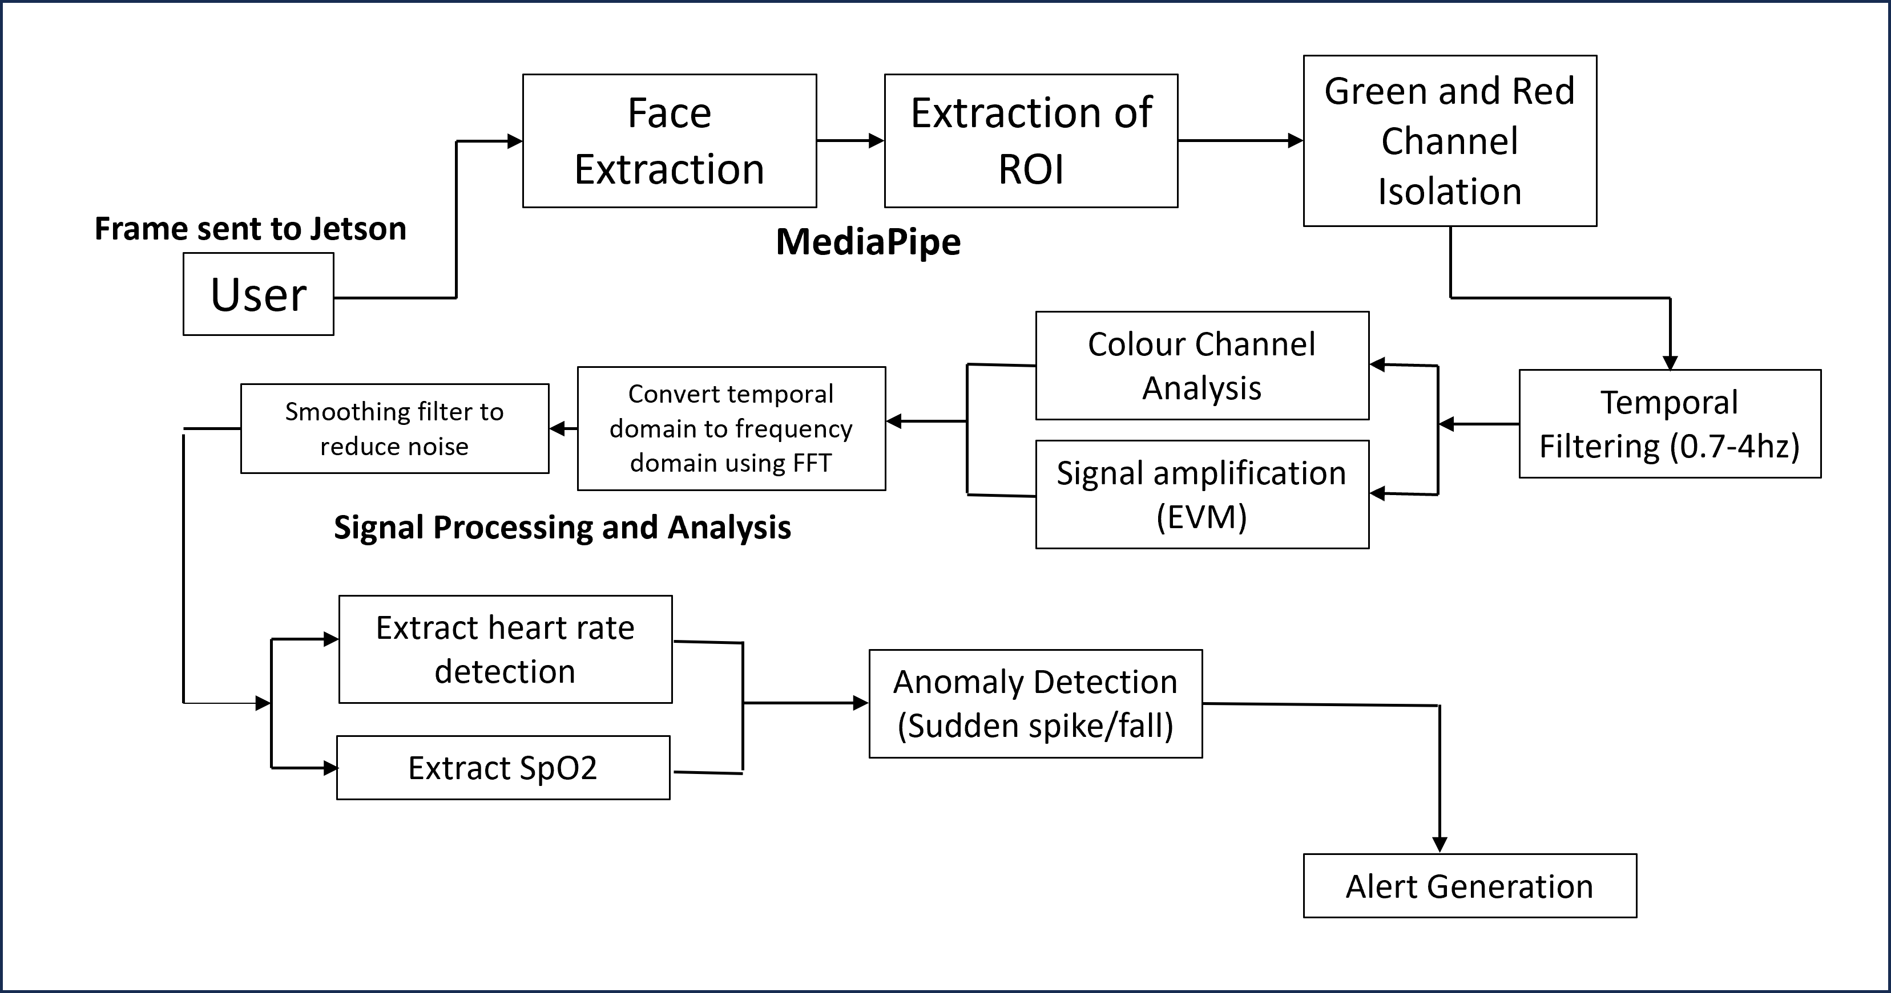
6. Features
Figure 1. Workflow of the proposed non-contact vital sign monitoring system, illustrating the sequential processes of face extraction, color channel isolation, signal amplification, and anomaly detection leading to automated alert generation.

Slide 9
7. Challenges & Learnings
Faced challenges in acquiring high-quality video data under varying lighting and environmental conditions.
Struggled with accurately extracting the region of interest (ROI) from facial videos due to movement and occlusion.
Encountered difficulties in optimizing the amplification factor in Eulerian Video Magnification without introducing artifacts.
Had to balance real-time processing constraints on the Jetson Nano while running multiple computationally intensive algorithms.
Overcame issues related to noise and motion artifacts through advanced filtering techniques.
Learned the complexities of calibrating color channel analysis for reliable SpO₂ estimation.

Slide 10
8. Future Scope & Next Steps
Expand clinical validation through extensive trials in diverse hospital environments.
Integrate the system with hospital information systems for seamless data sharing and alert dispatch.
Enhance algorithm robustness to accommodate variable lighting and significant motion artifacts.
Incorporate advanced machine learning models for predictive analytics and personalized monitoring.
Explore cloud-based solutions to enable scalable remote monitoring and data processing.

Slide 11
9. Conclusion & Thank You
One-Liner Pitch: TriNetra is a real-time, non-contact vital sign monitoring system that leverages advanced Eulerian Video Magnification and color channel analysis to accurately estimate heart rate and SpO₂ for proactive healthcare intervention.
Team Credits & Acknowledgments: Developed by Team TriNetra – Yuvraj Rana, Shivam Mehta, Rishikesh Shukla, and Ujjwal Mishra – we gratefully acknowledge the guidance and support of the Kraf Think 2025 organizers and mentors.

